Slide 1
Logic gates
Lecture 3
Prepared by : Eng.Amani Safwat

Slide 2
Logic Gates
Logic gates are electronic circuits used to perform logical operations on binary signals (0 and 1).
They are the basic building blocks of digital circuits such as computers, processors, and embedded systems.

Slide 3
Why We Use Logic Gates
We use logic gates to control the flow of signals within digital systems and to perform logical and arithmetic operations such as addition, comparison, and data storage. They form the foundation of all digital systems

Slide 4
Types of Logic Gates
(Basic Gates):
AND Gate
OR Gate
NOT Gate
(Universal Gates):
NAND Gate
NOR Gate
(Special Gates):
XOR Gate (Exclusive OR)
XNOR Gate (Exclusive NOR )

Slide 5
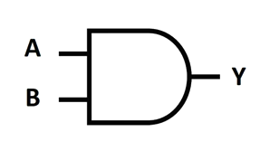
AND Gate
Outputs 1 only if all inputs are 1
Used when all conditions must be true
Symbol
Truth Table
A | B | Y
0 | 0 | 0
1 | 0 | 0
0 | 1 | 0
1 | 1 | 1
Equation :Y= AB OR Y=A.B

Slide 6
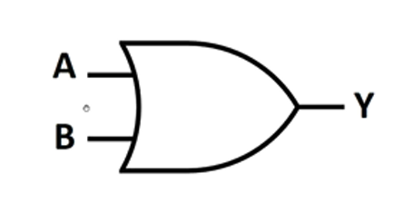
OR Gate
Outputs 1 if at least one input is 1
Used when only one condition needs to be true.
Symbol
Truth Table
A | B | Y
0 | 0 | 0
1 | 0 | 1
0 | 1 | 1
1 | 1 | 1
Equation :Y=A+B

Slide 7
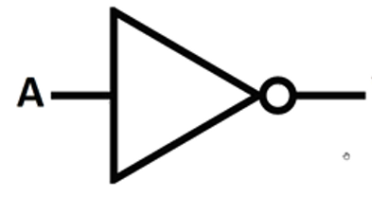
NOT Gate
Inverts the input; if input is 1, output is 0
Used to reverse logical states
Symbol
Truth Table
A | Y
0 | 1
1 | 0
Equation :Y=A

Slide 8
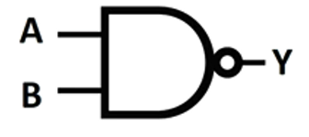
NAND Gate
The output is 0 only if all inputs are 1 (inverse of AND).
Used as a universal gate to build any logic circuit.
Symbol
Truth Table
A | B | Y
0 | 0 | 1
1 | 0 | 1
0 | 1 | 1
1 | 1 | 0
Equation :Y=AB

Slide 9
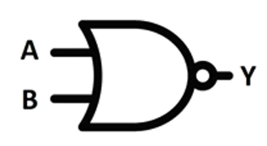
NOR Gate
Outputs 1 only when all inputs are 0 (inverse of OR).
Used as a universal gate to build any circuit
Symbol
Truth Table
A | B | Y
0 | 0 | 1
1 | 0 | 0
0 | 1 | 0
1 | 1 | 0
Equation :Y=A+B

Slide 10
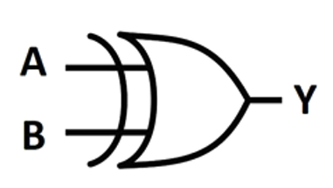
XOR Gate
Outputs 1 only when inputs are different
Used in adder and comparator circuits
Symbol
Truth Table
A | B | Y
0 | 0 | 0
1 | 0 | 1
0 | 1 | 1
1 | 1 | 0
Equation :Y=A B

Slide 11
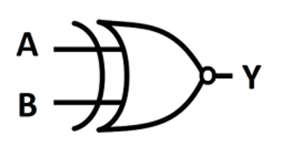
XNOR Gate
Outputs 1 only when inputs are the same
Used in equality comparator circuits
Symbol
Truth Table
A | B | Y
0 | 0 | 1
1 | 0 | 0
0 | 1 | 0
1 | 1 | 1
Equation :Y=A B

Slide 12
Universal Gates

Slide 13
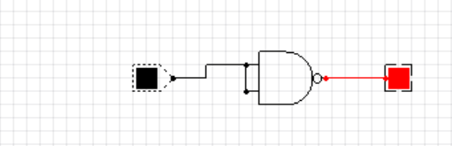
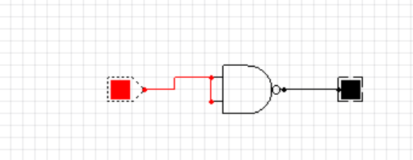
NAND Gate
NOT using NAND:
Y = (A · A)′ → gives the same output as NOT.

Slide 14
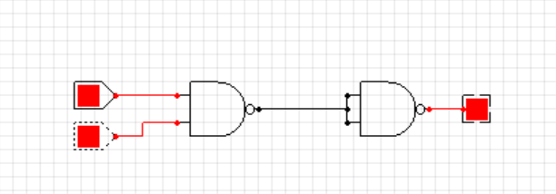
NAND Gate
AND using NAND:
Y = ((A · B)′)′ → We use two NAND gates.

Slide 15
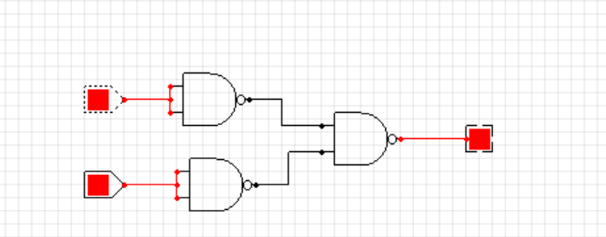
NAND Gate
OR using NAND:
Y = ((A′) · (B′))′ → We use three NAND gates.

Slide 16
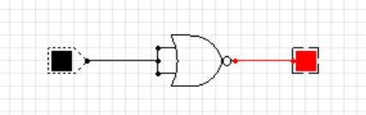
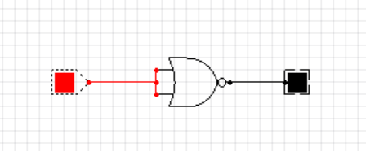
NOR Gate
NOT using NOR:
Y = (A + A)′ → Same result as NOT

Slide 17
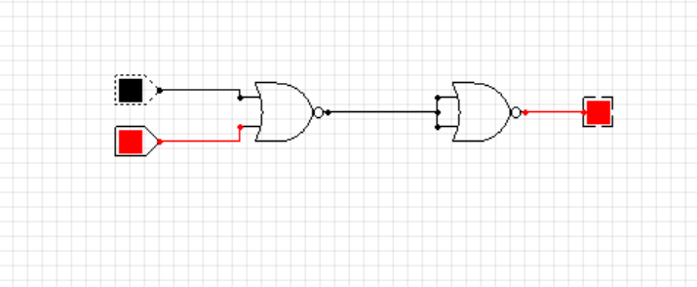
NOR Gate
OR using NOR:
Y = ((A + B)′)′ → We use two NOR gates

Slide 18
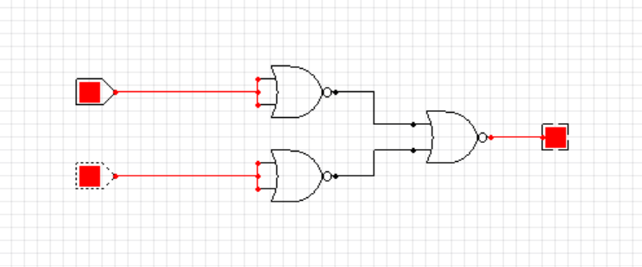
NOR Gate
AND using NOR:
Y = ((A′) + (B′))′ → We use three NOR gates

